Slide 1
City Guide Application
Group32
05190000072, Tuğcan TOPALOĞLU 05180000070, Doğukan ARGÜÇ 05190000902, Lale Elif YEŞİL 05190000764, Osman CANBOĞA

Slide 2
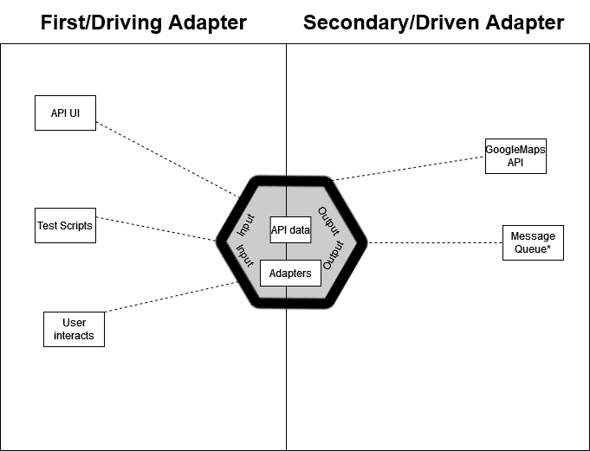
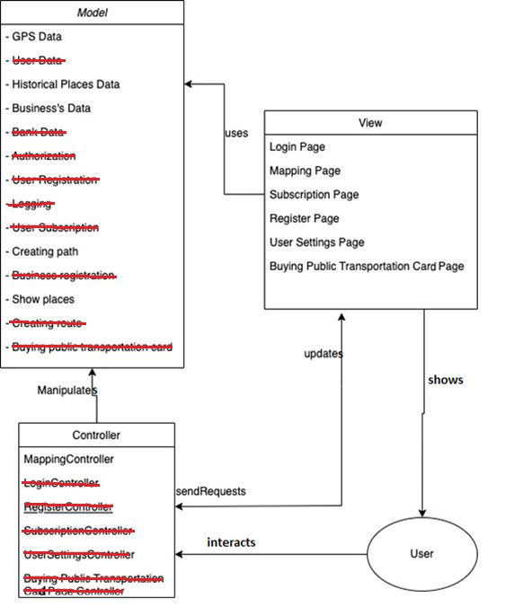
Architectural Model

Slide 3
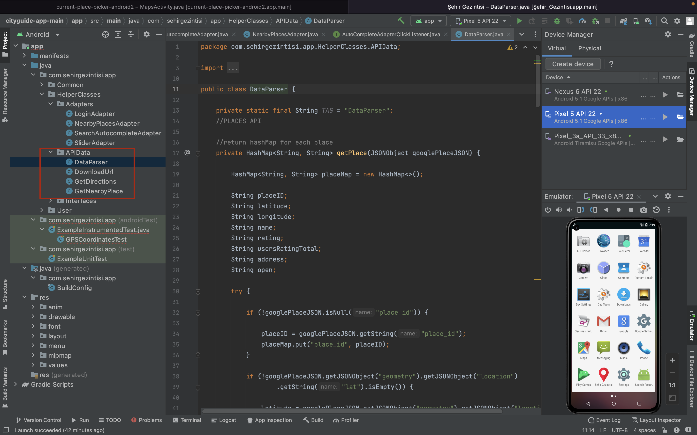
Relationship
API Data

Slide 4
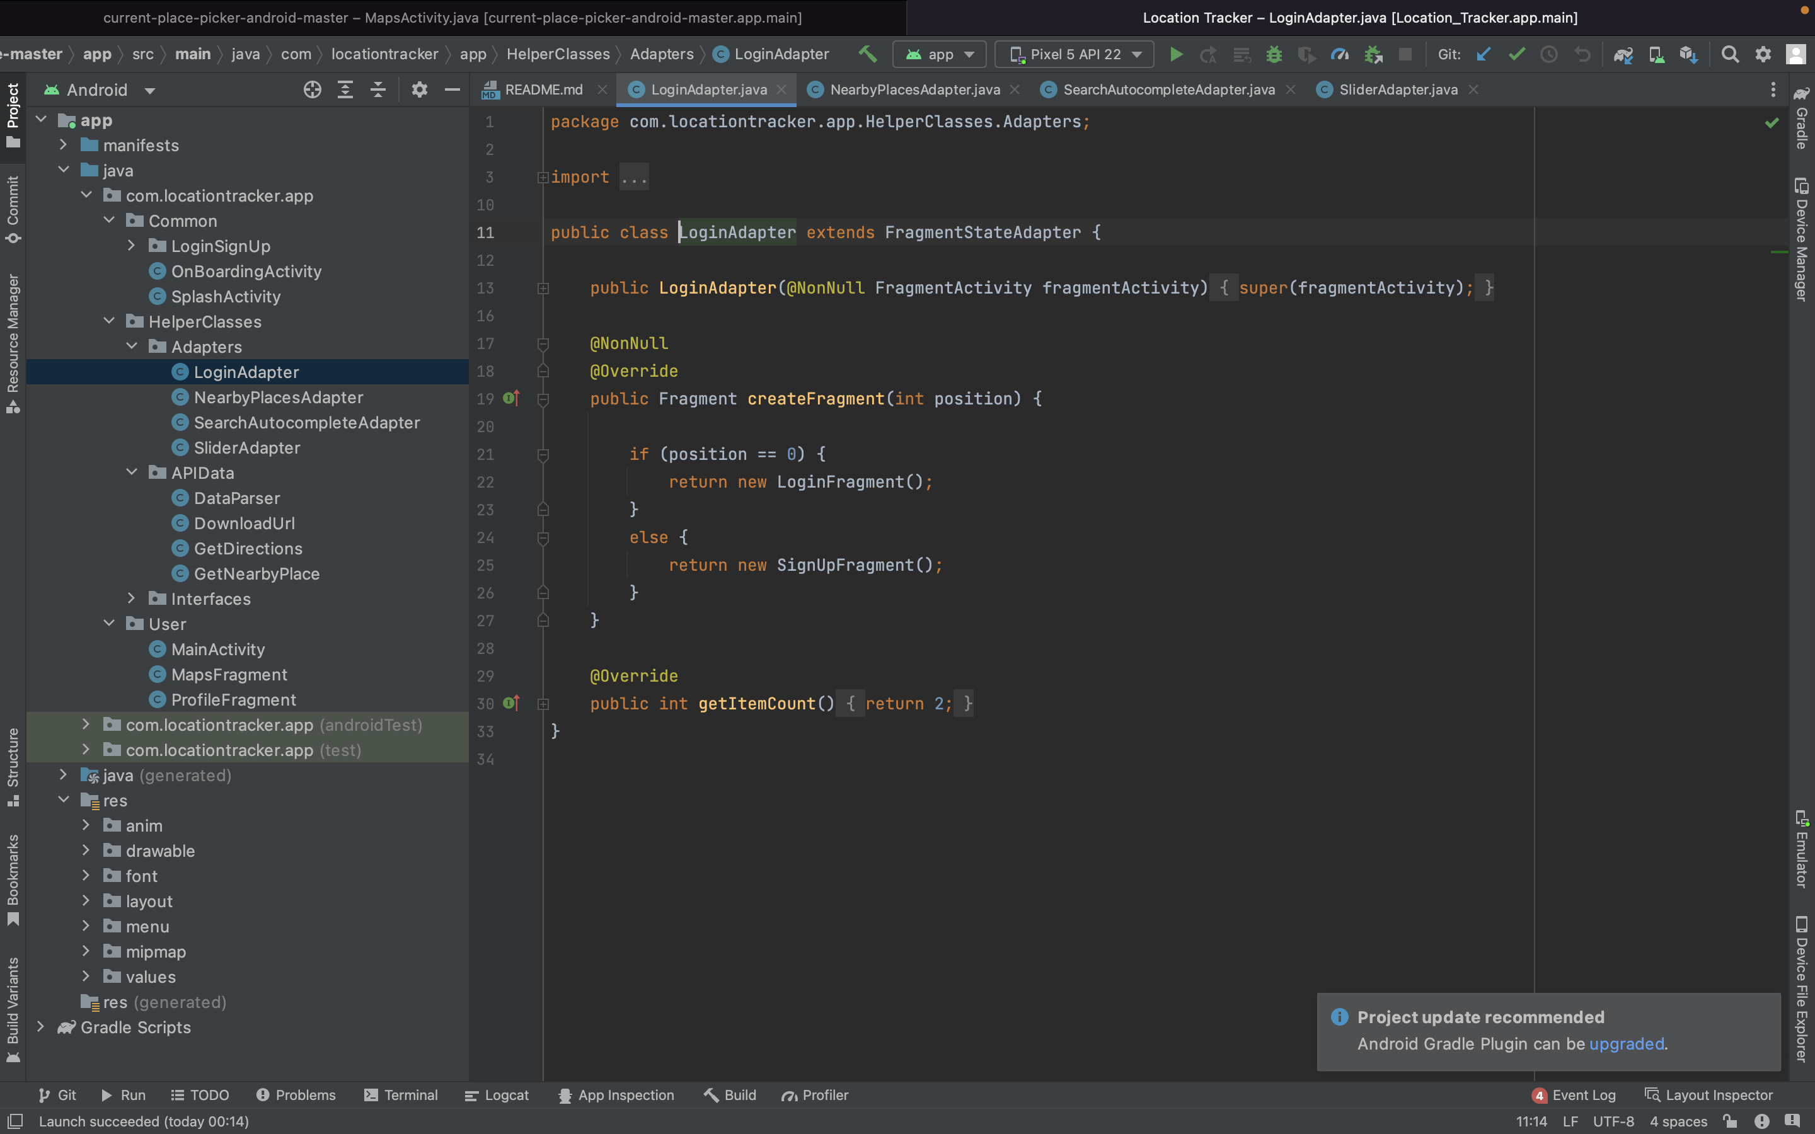
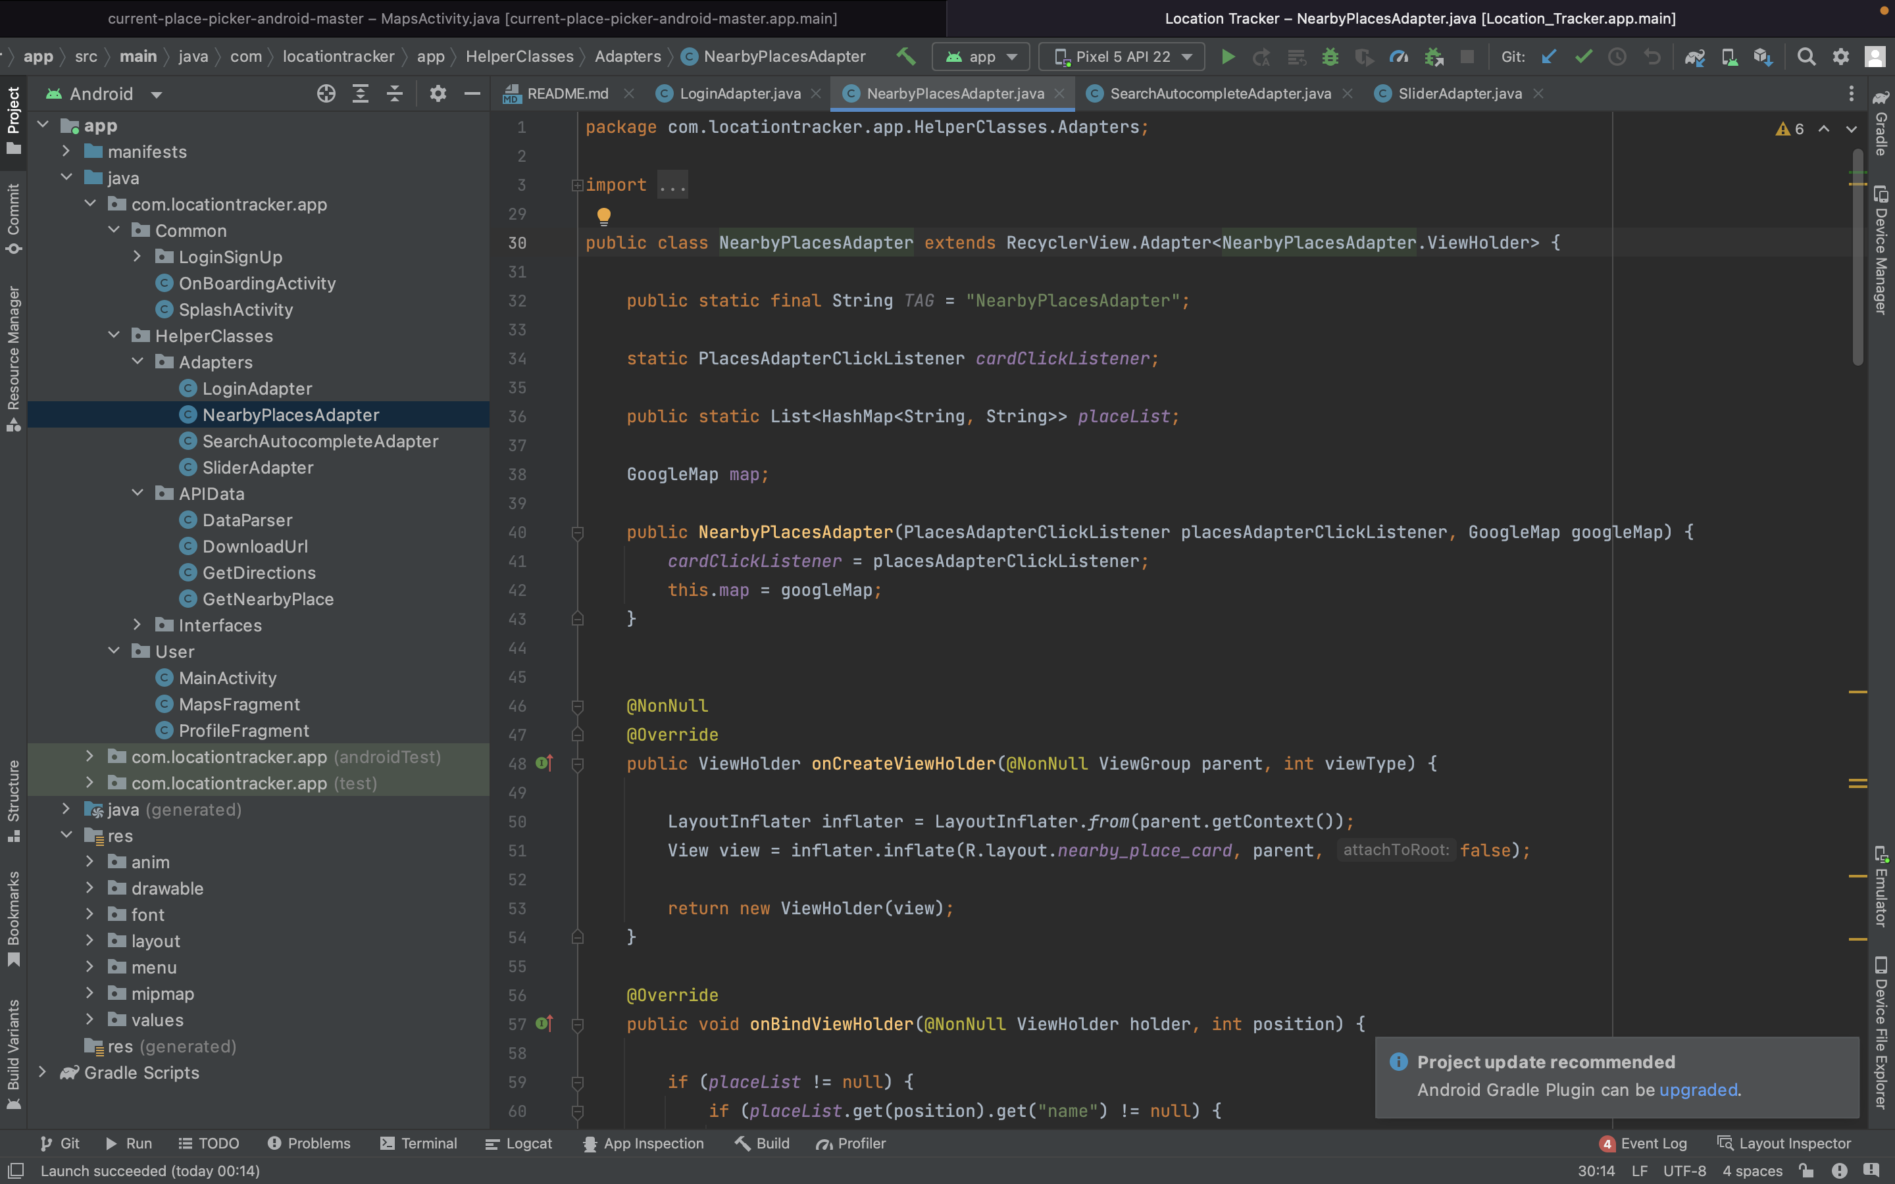
Relationship
Adapters

Slide 5
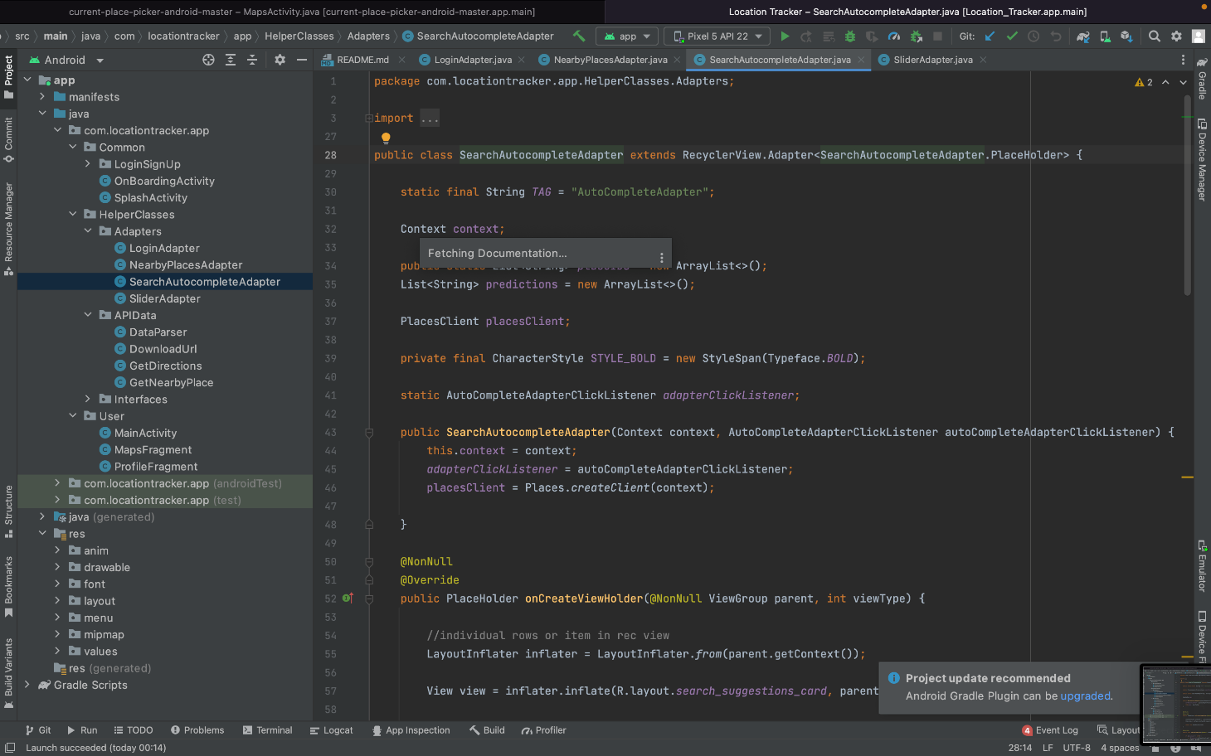
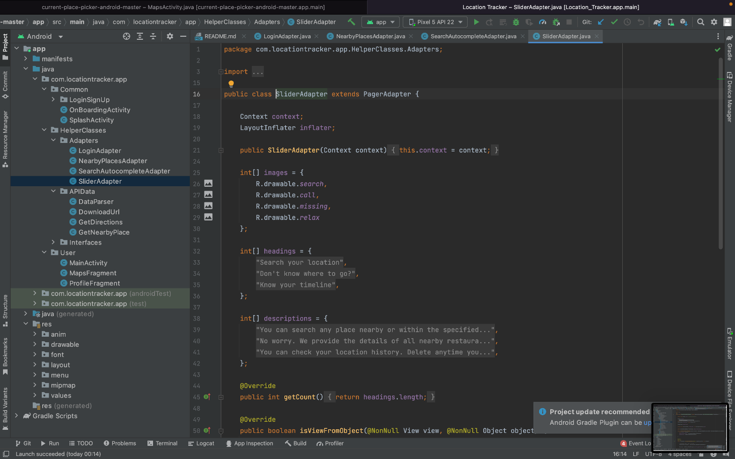
Relationship
Adapters

Slide 6
UI Criterias
Easy to use: The interface is designed to be simple and understandable for users to use easily.
Easy to learn: At the first entry to the application, a small brochure awaits the user, explaining what to do and how.
User familiarity: Application icons (password, mail, restaurant, hotel, atm, sights,) are selected according to the literature and user familiarity.
Consistency: Menus, buttons and text boxes are designed in the same format.
User guidance: At the first entry to the application, a small brochure awaits the user, explaining what to do and how.
User diversity: Because of its ease of use and learning, anyone who can read and write and can use a smart phone can use this application.
Form fill-in: UI is designed appropriately to fill-in forms with loggining, registering, searching place.

Slide 7
Test Cases
Test Case Name: Displaying Space Distances on the Map Screen
Inputs:
Kullanıcı uygulamayı açar ve harita ekranına gider.
Expected Outputs:
The user opens the application and goes to the map screen.
Test Data:
User's current location : 38.458067946928296, 27.213105269283066 (in Turkiye, Izmir)
Nearby venues:
Mekan 1: 38.457067946928296, 27.210105269283066 (3 km away)
Mekan 2: 38.459067946928296, 27.215105269283066 (5 km away)
Realized Outputs:
The map screen opens, but the user's current location is shown. The surrounding places are not shown and the distances of the places are not shown either.
Test result: Failed

Slide 8
Test Cases
Test Case Name: Displaying Space Distances on the Map Screen
Inputs:
The user opens the application and goes to the map screen.
Expected Outputs:
The map screen opens and displays the current location of the user.The places around the user are shown. The distances of the places are also shown.
Test Data:
User's current location : 38.458067946928296, 27.213105269283066 (in Turkiye, Izmir)
Nearby venues:
Mekan 1: 38.457067946928296, 27.210105269283066 (800 m away)
Mekan 2: 38.459067946928296, 27.215105269283066 (1.5 km away)
Realized Outputs:
The map screen opens and displays the user's current location as 38.458067946928296, 27.213105269283066. The surrounding venues are shown as 38.457067946928296, 27.210105269283066 and 38.459067946928296, 27.215105269283066 and the distances of the venues are shown as 800m and 1.5km.
Test result: Success

Slide 9
Test Cases
Test Case Name: Viewing Interests on the Map Screen
Inputs:
The user opens the application and goes to the map screen.The user clicks one of the "Restaurants", "Hotels", "ATMs" or "Places of Interest" button on the map screen.
Expected Outputs:
Displaying places labeled as a clicked point of interest on the map screen.
Realized Outputs:
Harita ekranında tıklanan ilgi alanı olarak etiketlenmiş mekanlar gösterilir.
Test result: Success

